Slide 1
Checkpoint #4 Full Function Demonstration
Due: 12/4/2020

Slide 2
Outline
CP 4 Supplies Check
Checkpoint #4
Introduction to IR receiver
Goal Seeking
Checkpoint#4 Grading Policy

Slide 3
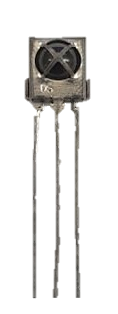
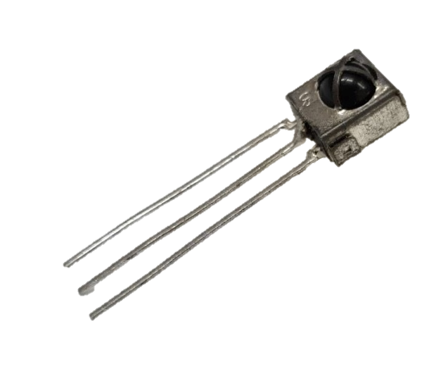
CP 4 Supplies

Slide 4
Checkpoint#4 Assignment
Mobile robot can detect beacon signals and move towards it.
Combine all the function together for robot hockey contest.
Obstacle Avoidance
Puck Seeking (Light-ball detection)
Goal Seeking (IR signal receiving and moving toward goal)
Two infrared diodes will be set up at opposite ends of an arena. Each diode will be emitting light modulated at 38 KHz, but their pulse width are different when received by IR receiver module.

Slide 5
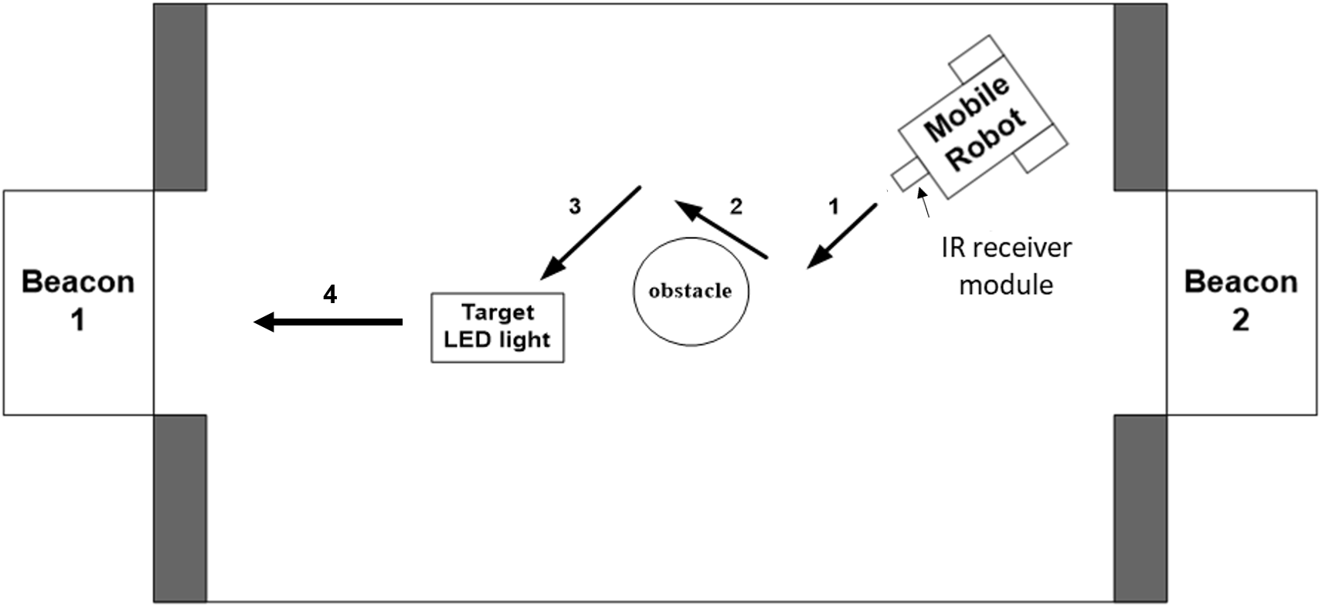
Arena

Slide 6
IR receiver
Using IR receiver to find beacons(Beacon-1 600 and Beacon-2 1500) which is the goal.
OS
Signal/Output
GND
5V

Slide 7
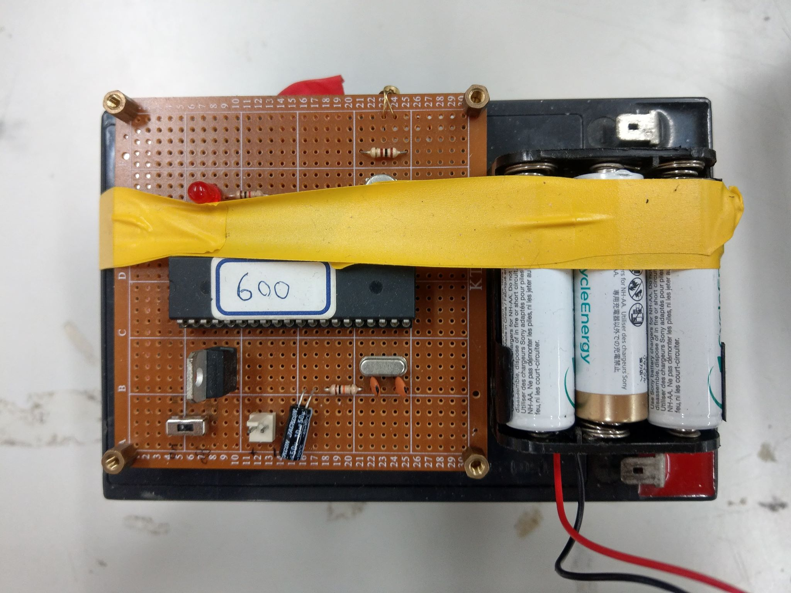
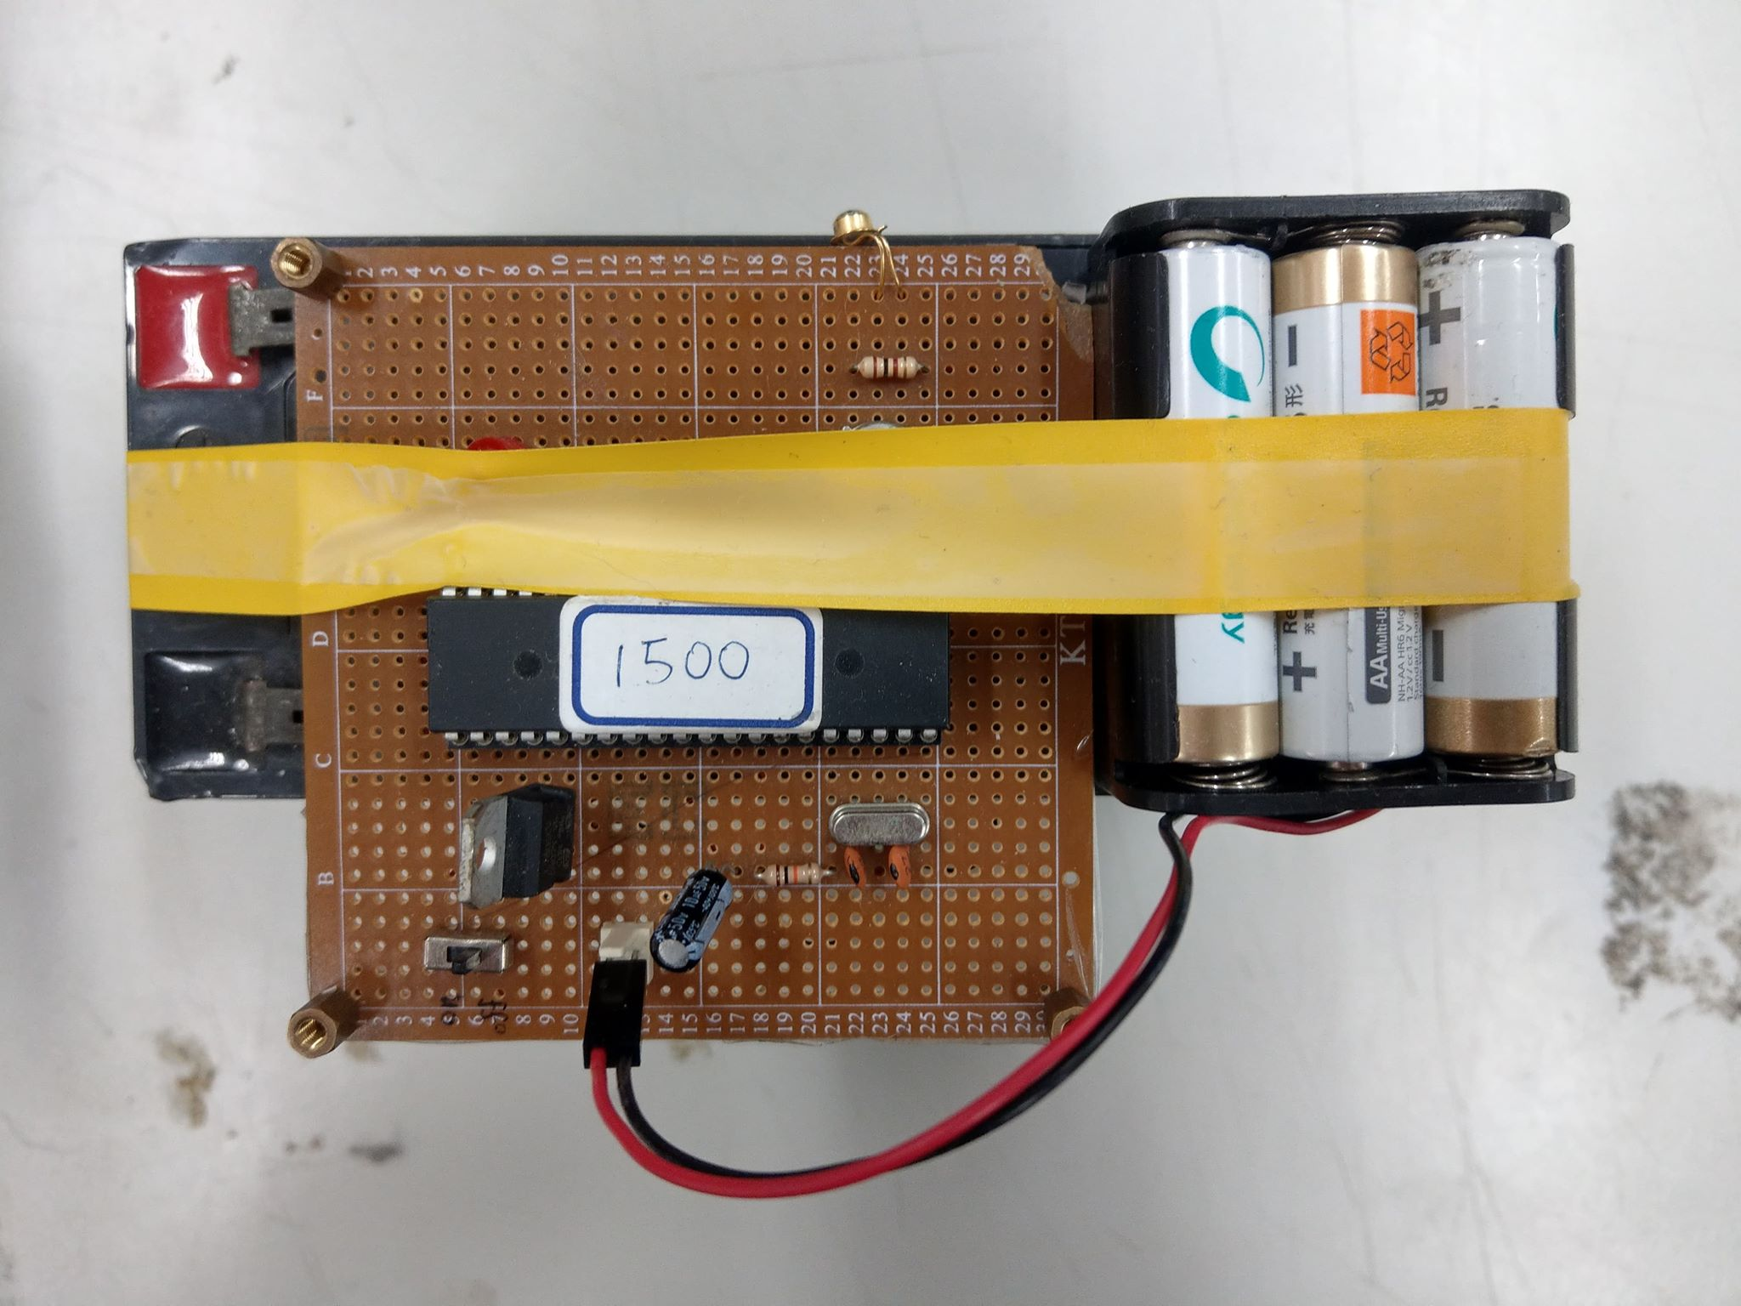
Beacon (Provided by TA)
Two infrared diodes are set up at opposite ends of the arena.
Each Beacon will emit light modulated at 38KHz, but their pulse widths are different when received by the IR receiver module.
Beacon-1 600
Beacon-2 1500

Slide 8
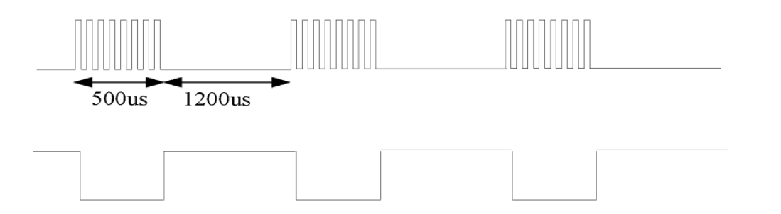
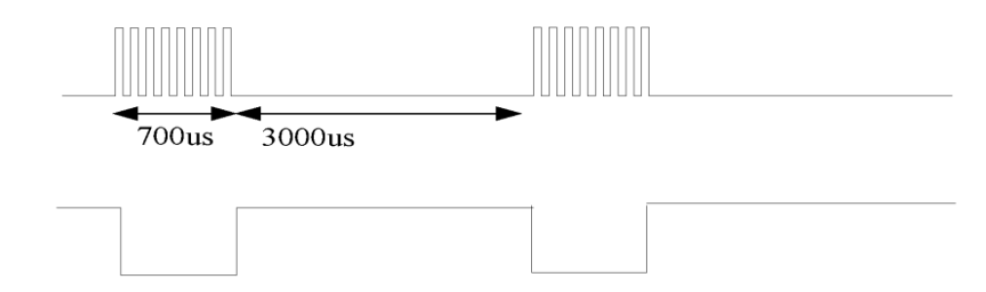
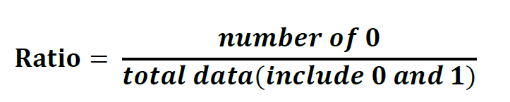
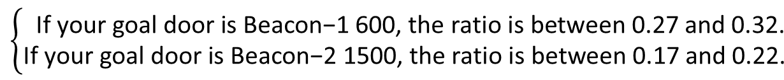
Beacon
Beacon-1 600
Beacon signal
1
IR receiver
0
Beacon-2 1500
Beacon signal
IR receiver
1
0
Receive IR data for a period of time(≥0.1 seconds) and calculate the pulse proportion.
$$\left\{\begin{aligned}\text{If} \text{your} \text{goal} \text{door} \text{is} \text{Beacon}\text{−1 600, }\text{the} \text{ratio} \text{is} \text{between}\text{ 0.27 }\text{and}\text{ 0.32.} \\ \text{If} \text{your} \text{goal} \text{door} \text{is} \text{Beacon}\text{−2 1500, }\text{the} \text{ratio} \text{is} \text{between}\text{ 0.17 }\text{and}\text{ 0.22. } \end{aligned}\right.$$

Slide 9
Grading Policy
Have the ability to avoid all the obstacle in the arena. (20%)
Capture the hockey puck. (20%)
Your robot should be able to find two different beacons (Beacon-1 600 and Beacon-2 1500) and move to the specified beacon in the arena and bring the puck into the goal , respectively, of Beacon1 and Beacon 2. (25%)
The time to complete the goal of Beacon-1 600 and the goal of Beacon-2 1500 (25%).
Should complete the mission in 120sec. (The completing time will be counted for grading.)(10%)

Slide 10
Checkpoint#4 | Checkpoint#3 Demo Grading
09:00 ~ 09:30 Assignment and TA Demo | Group A 09:30 ~ 10:30 | Group B 10:30 ~ 11:30
 | Team 6 | Team 13
 | Team 5 | Team 12
 | Team 4 | Team 11
 | Team 3 | Team 10
 | Team 2 | Team 9
 | Team 1 | Team 8
 |  | Team 7
Deadline
------------------------------------------------------Checkpoint#4 Demo : 12/4
Checkpoint #4 Report : 12/11

